Slide 1
Capstone Project-2 Supervised ML- Regression
NYC TAXI TIME PREDICTION
BY:
Kanika Bhardwaj

Slide 2
Outlines to Discuss:
•Introduction
•Exploring dataset
•Methodology
•EDA and Data Processing
•ML model regression
•Conclusion

Slide 3
Problem Statement
Our task is to build a model that predicts the total ride duration of taxi trips in New York City.
Our primary dataset is one released by the NYC Taxi and Limousine Commission, which includes pickup time, geo-coordinates, number of passengers, and several other variables.

Slide 4
Data Summary
The dataset is based on the 2016 NYC Yellow Cab trip record data made available in Big Query on Google Cloud Platform. The data was originally published by the NYC Taxi and Limousine Commission (TLC).
Data fields:
id - a unique identifier for each trip
vendor_id - a code indicating the provider associated with the trip record
pickup_datetime - date and time when the meter was engaged
dropoff_datetime - date and time when the meter was disengaged
passenger_count - the number of passengers in the vehicle (driver entered value)
pickup_longitude - the longitude where the meter was engaged
pickup_latitude - the latitude where the meter was engaged
dropoff_longitude - the longitude where the meter was disengaged
dropoff_latitude - the latitude where the meter was disengaged
store_and_fwd_flag - This flag indicates whether the trip record was held in vehicle memory before sending to the vendor because the vehicle did not have a connection to the server
trip_duration - duration of the trip in seconds

Slide 5
Data Summary
market_segment:This column show how reservation was made and what is the purpose of reservation. E.g., corporate means corporate trip, TA for travel agency.
distribution_channel:The medium through booking was made.[Direct,Corporate,TA/TO, undefined,GDS.]
Is_repeated_guest:Shows if the guest is who has arrived earlier or not. Values[0,1]-->0 indicates no and 1 indicated yes person is repeated guest.
days_in_waiting_list: Number of days between actual booking and transact.
customer_type: Type of customers( Transient, group, etc.)

Slide 6
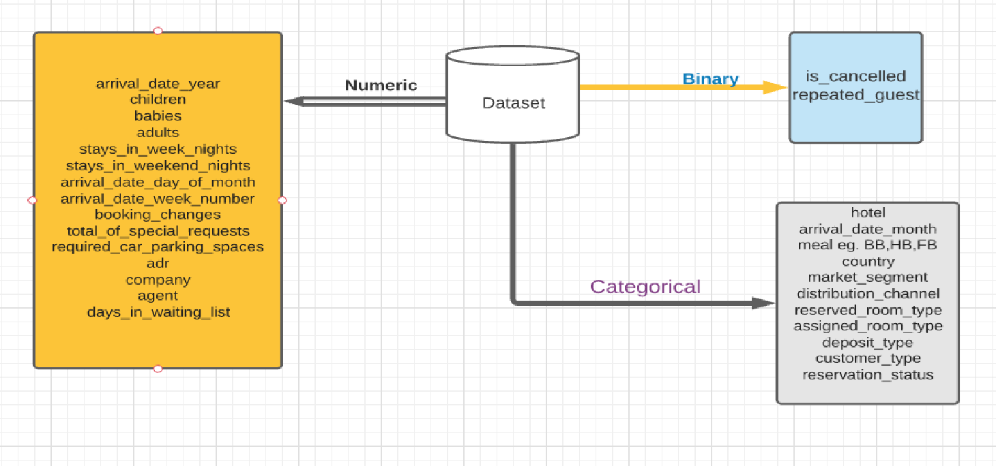
Data Summary

Slide 7
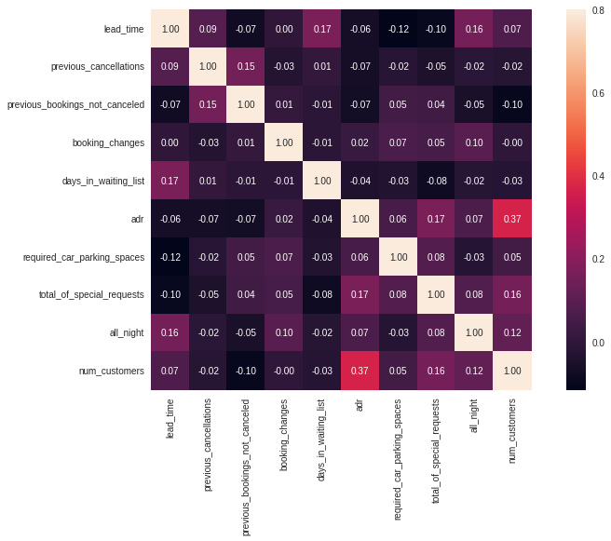
Correlation between every columns with numerical values.
ADR and number of customers is slightly correlated. This means for more number of customers, ADR is high as service requirement is high in case of more number of customers.

Slide 8
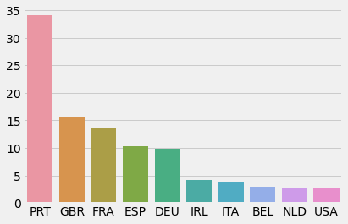
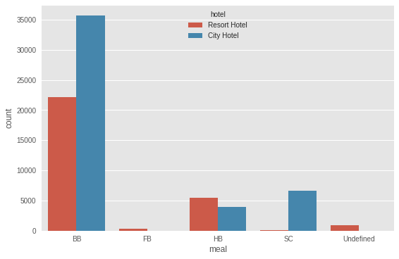
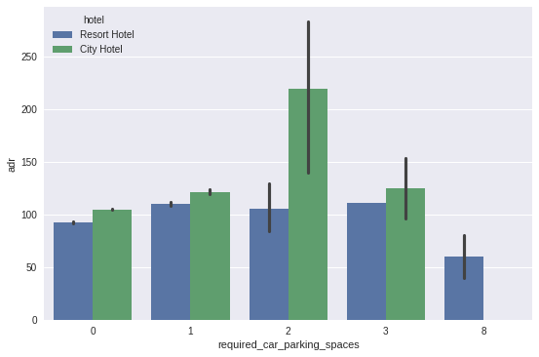
Some basic analysis
Most of the customers are from Portugal followed by Great Britain, France, Spain.
Demand for BB i.e. Bed and Breakfast high in both of the hotels compared to another meal types.
Demand for car parking with 2 spaces is high in City hotels.
Demand for 1 and 3 parking spaces is high in resort hotels.

Slide 9
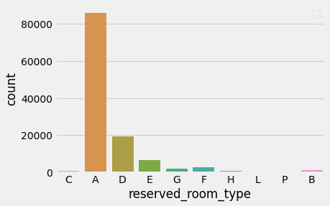
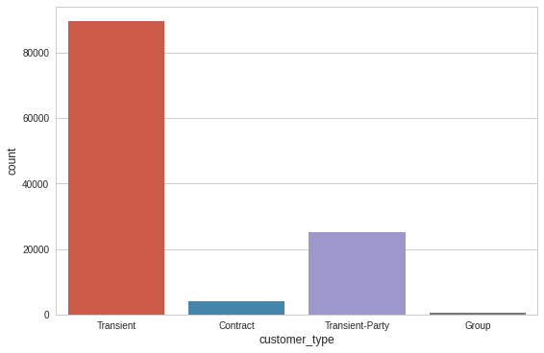
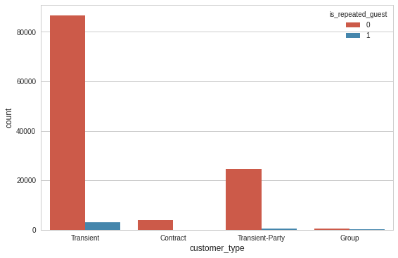
Some basic analysis(Continued)
Most of the customers prefer Type A hotel rooms
Most of the customers are of Transient type. They are staying for short time periods.
Though there is very nominal margin of repeated customers, most of them are transient type.

Slide 10
Hotel wise analysis.
The booking ratio between Resort Hotel and City Hotel
Average ADR variation Hotel wise.
Different hotels booked month wise.
Different hotels booked year wise.
Staying at night in different hotels.

Slide 11
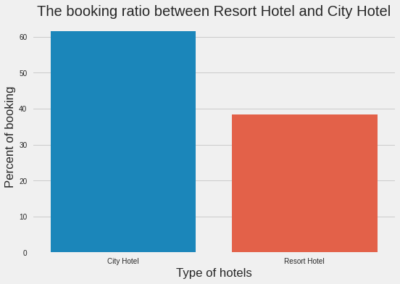
The booking ratio between Resort Hotel and City Hotel
The percentage of booking in City hotel is above 61.5%.
The percentage of booking in Resort hotel is 38.5%.

Slide 12
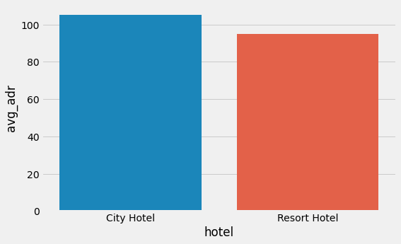
Average ADR variation Hotel wise.
As we have seen in the previous chart that demand in City hotel is high so the adr average is also high. It can be said that City hotel is generating more revenues than Resort hotels.

Slide 13
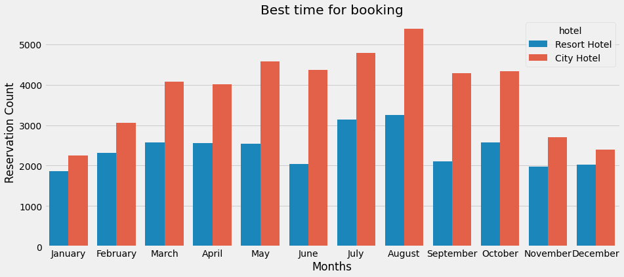
Different hotels booked month wise.
City Hotel booking is high in July and August month.
Resort Hotel booking is high in July and August month also but the demand is low compared to City hotel.

Slide 14
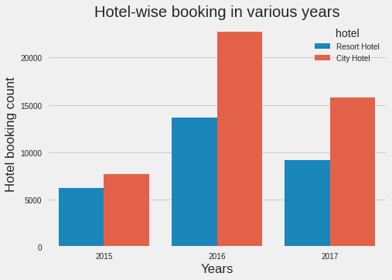
Different hotels booked year wise.
Hotels were mostly booked in 2016
Demand in City Hotels are high in every year.
In 2016, which is the most demanded year, City hotel demand is higher by 1.75x compared to Resort hotel.

Slide 15
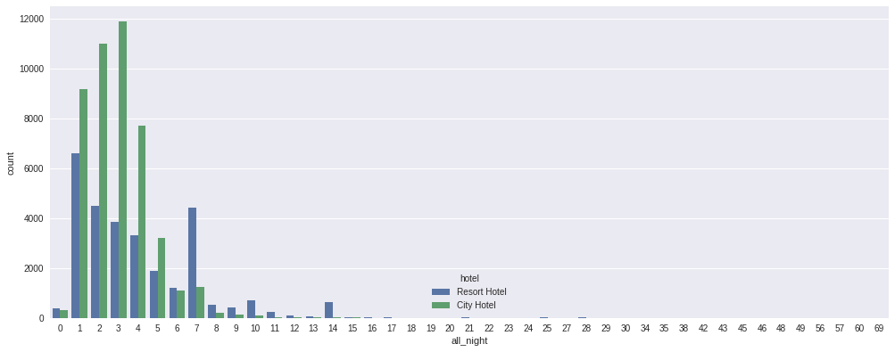
Staying at night in different hotels.
Customers who are preferring City hotels, stays mostly multiple nights of range one to five.
Customers who are preferring Resort hotels, stays mostly multiple nights of range one to seven.

Slide 16
Distribution Channel wise analysis
Distribution channel wise average ADR.
Distribution channel wise lead time variation.

Slide 17
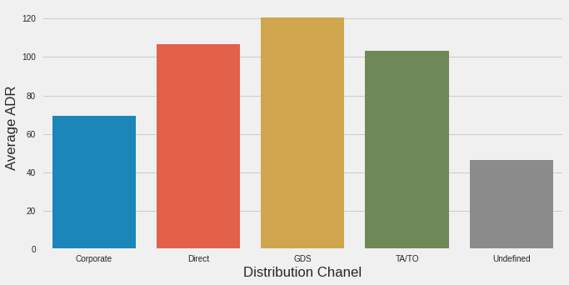
Distribution channel wise average ADR.
Average ADR is highest in GDS chanel, followed by Direct and TA/TO.

Slide 18
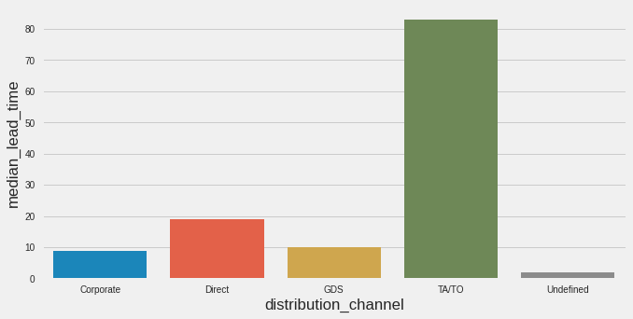
Distribution Chanel wise lead time variation.
For TA/TO i.e. Travel Agencies/ Travel Operator lead time lead time is high. If any customer is booking hotels through TA/TO they should book the hotel several days before compared to other booking channels.

Slide 19
Booking cancellation analysis
Cancellation based on lead time and waiting time.
Hotel cancellation on various months.
Cancellation of hotels in various distribution channels.

Slide 20
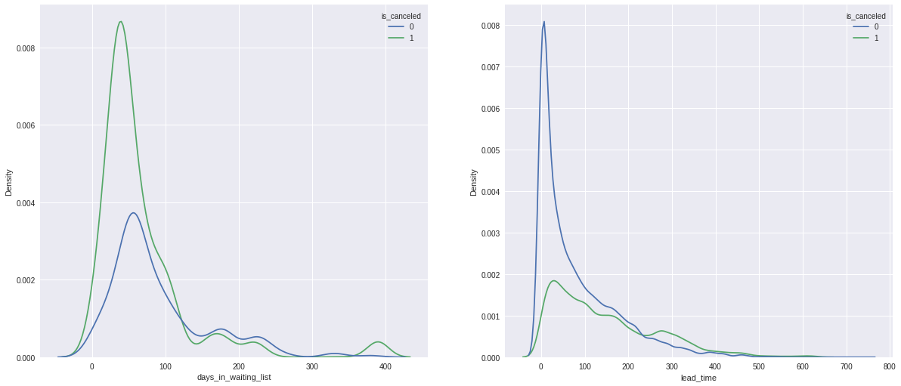
Cancellation based on lead time and waiting time.
In both of the above plot it is seen that customers who cancelled and those who did not cancelled the bookings have lead time and waiting list mostly in the range of 150 days. So we can say lead time and waiting days have no relation with booking cancellation.

Slide 21
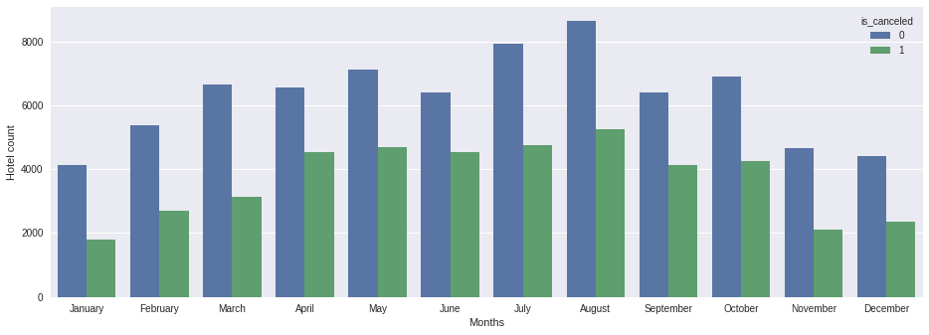
Hotel cancellation on various months.
It can be concluded that cancellation of booking is highest in August.
April, May, June, July have almost same number of cancellation count.

Slide 22
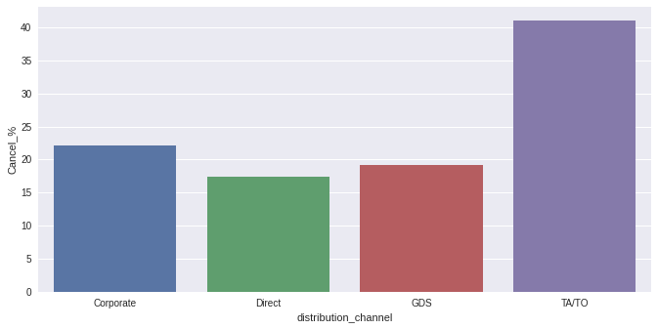
Cancellation of hotels in various distribution channels.
Cancellation percentage of cancellation of hotels is higher in Travel Agencies/ Travel Operators.

Slide 23
Analysis based on size of customer groups( Single, Couple, Family).
Various customer type and their hotel preferences.
Various customer types and their preferable booking months.

Slide 24
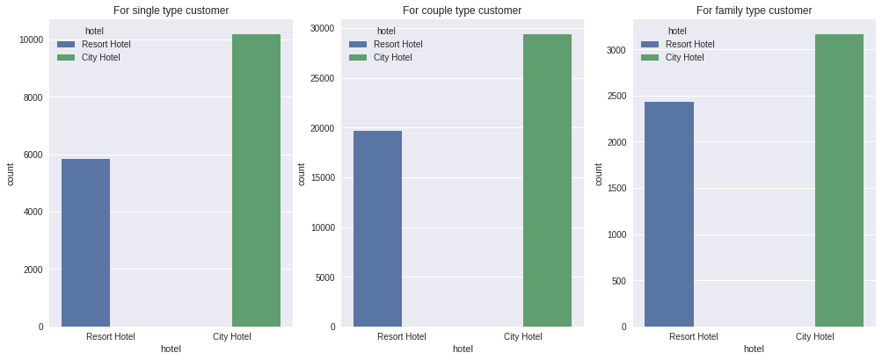
Various customer type and their hotel preferences.
There are mostly couple type customers i.e. two adults.
For any type of customers (Single, Couple, Family) preferences is higher in booking City hotels than Resort hotels.

Slide 25
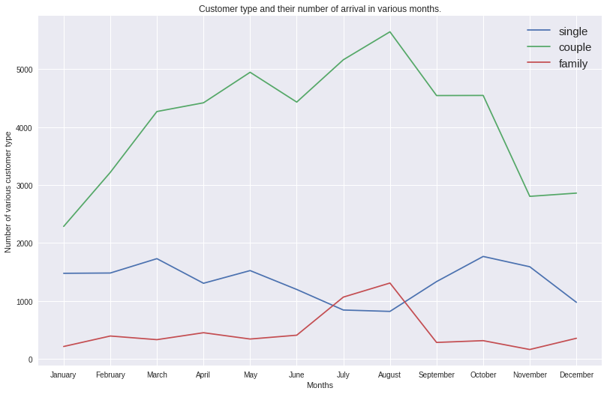
Various customer types and their preferable booking months.
In case of Couple and Family type customers preferences are high in booking hotels in July and August.
But in case of Single type customers they are preferring March and October mostly.
We can predict that Singles are preferring Summer and Winter holidays mostly.

Slide 26
Some important questions
When the best time of year to book a hotel room is?
The optimal length of stay in order to get the best daily rate?
What if you wanted to predict whether or not a hotel was likely to receive a disproportionately high number of special requests?

Slide 27
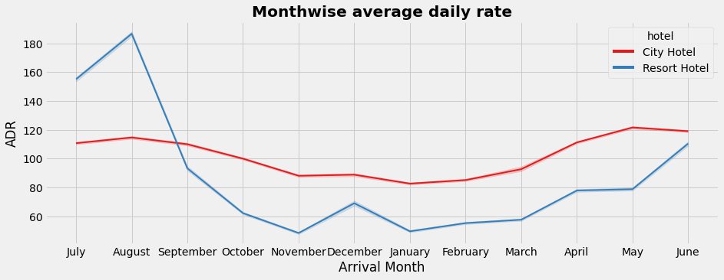
When the best time of year to book a hotel room is?
As the demand is high in City hotels in the month of July and August so the ADR is also high for those particular months.
ADR is higher in May, June in case of Resort hotels. Customers are preferring summer times in Resort hotels.
The optimal time for booking the hotels is January and December to get the best daily rates

Slide 28
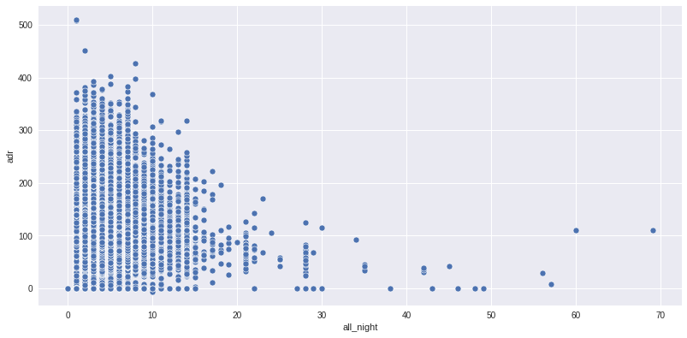
The optimal length of stay in order to get the best daily rate?
Customers who are staying in the hotels more than 20 days can get the best daily rate.

Slide 29
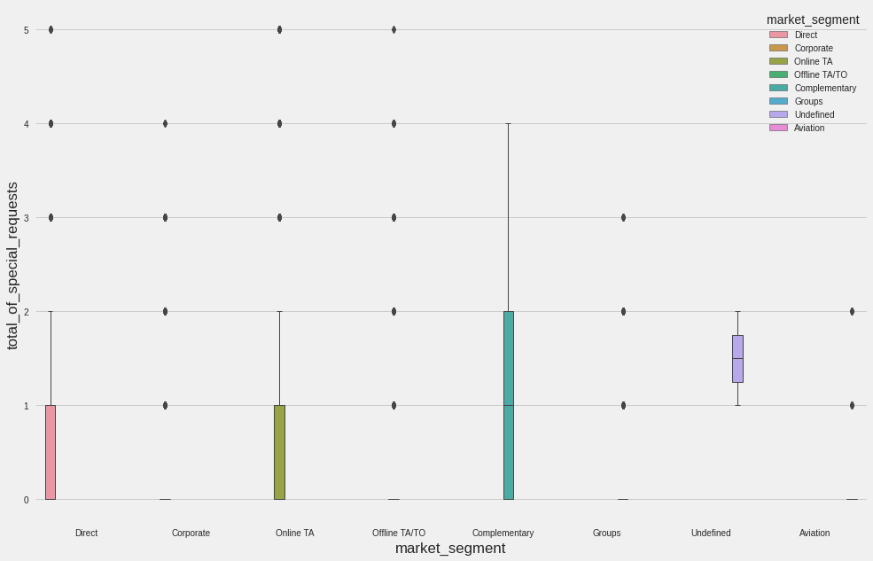
What if you wanted to predict whether or not a hotel was likely to receive a disproportionately high number of special requests?
We can conclude from this chart that from every market segment the hotels are getting disproportionately high number of special requests.

Slide 30
Conclusion
Around 61.5% bookings are for City hotels and 38.5% bookings are for Resort hotels, therefore City Hotels are busier than Resort hotels. Also the overall ADR of City hotels is slightly higher than Resort hotels.
Mostly guests stay for less than 5 days in hotel and for longer stays Resort hotel is preferred.
Most of the customers came from European countries, with most of them coming from Portugal.
Customers use different channels for making bookings out of which most preferred way is TA/TO.
For hotels higher ADR deals come via GDS channel, so hotels should increase their popularity on this channel.
Nearly 30% of bookings via TA/TO are cancelled.
More number of people in guests results in more number of special requests.
Most of the customers prefer Type A rooms.
Longer lead time and waiting time do not affect cancellation of bookings.
July-August are the most busier and profitable months for both of hotels.
Couples are the most common guests for hotels, hence hotels can plan services according to couples needs to increase revenue.
Singles prefers summer and winter holidays over other months. Hotels should provide better deals for singles at that time.
For customers, generally the longer stays (more than 20 days) can result in better deals in terms of low ADR.
City hotels should provide more two spaced parking and Resort hotels should provide more one and three spaced parking in order to get more bookings.

